Slide 1

COMPUTATIONAL FLOW OVER DELTA WING
Ninu Limboo
22m0015

Slide 2
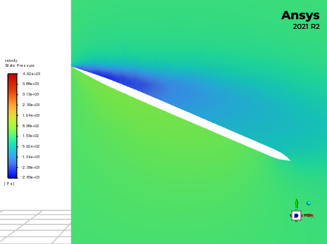
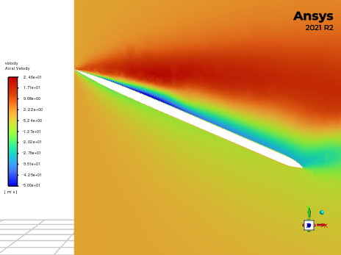
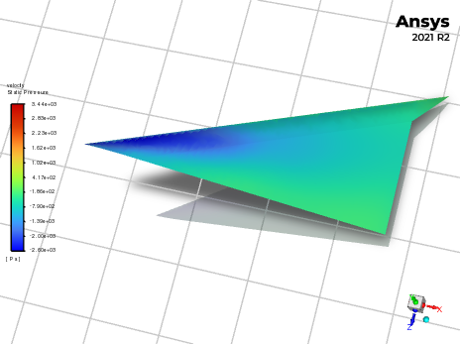
At 25 degree angle of attack

Slide 3
At 35 degree angle of attack

Slide 4
DAY 2 : 19/7/23

Slide 5
Dimensions of delta wing geometry
 | Aspect Ratio(b/c) | 0.932
 | b(wing span) | 186.4
 | c(root chord) | 200
Wing | Sweep angle | 65
 | Thickness ratio(t/c) | 0.034
 | Sw | 37280

Slide 6
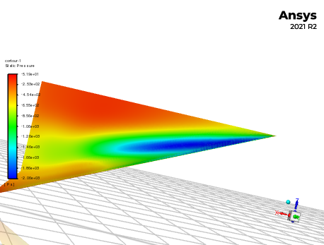
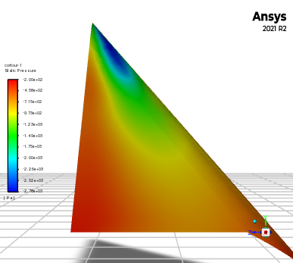
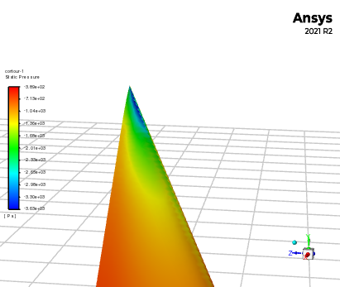
Pressure over the top surface of delta wing
23 deg
35 deg
45 deg
* Vortex core is the region of lowest pressure and as angle of attack increases velocity increases and pressure decreases in the core of the primary leading edge vortex.

Slide 7
Cd, Cl Vs Angle of attack

Slide 8
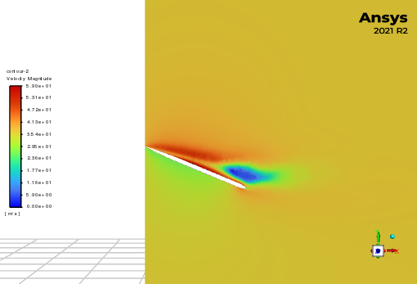
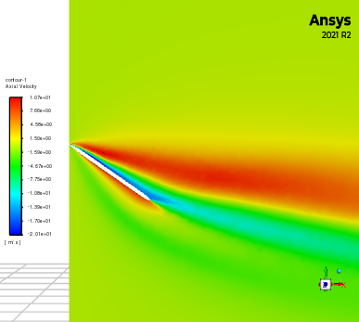
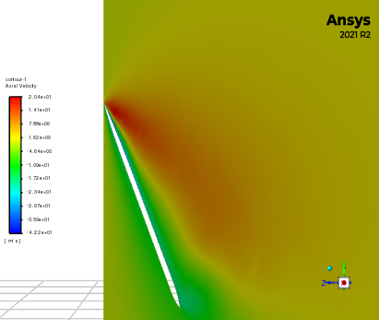
Axial velocity at 23, 35, 45 degrees
23 deg
35 deg
45 deg
* When the breakdown happens, axial velocity decreases suddenly.

Slide 9
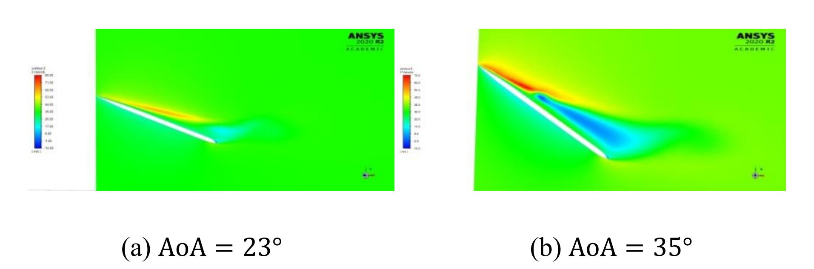
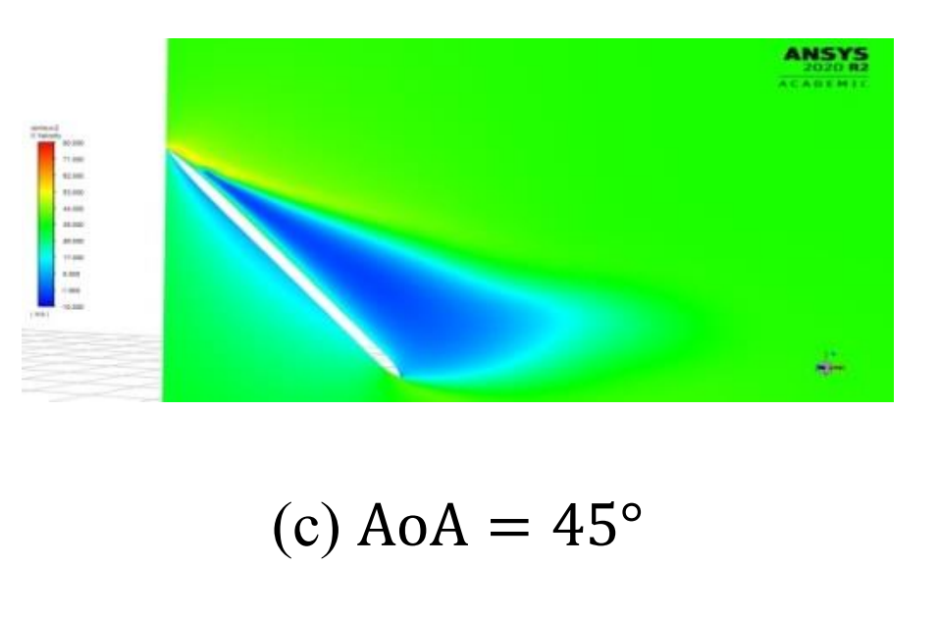

Slide 10
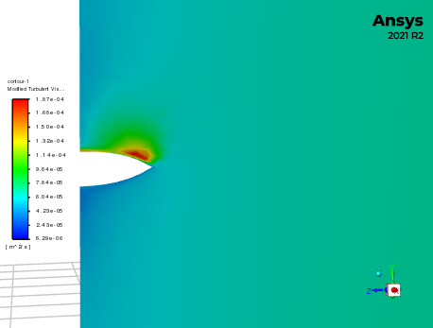
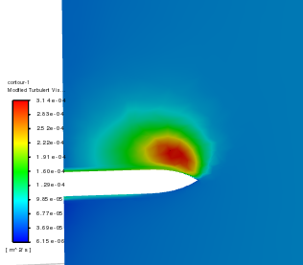
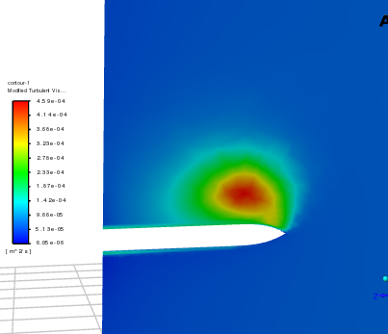
Modified turbulent viscosity
X= 0.12
X=0.03
X=0.08

